Slide 1






Foundations of
Quantum Information Science (QIS 101)
Dave Biersach
Brookhaven National Laboratory
dbiersach@bnl.gov
Session 23
Quantum Circuits

Slide 2
Session 23 – Goals
Compare and contrast state transitions represented by real matrices (probabilities) vs. complex matrices (amplitudes)
Appreciate the crucial role of interference (phase cancellation) in the superposition of complex waves
Map Terry Rudolph's PETE box to the concept of superposition obtained by applying the Hadamard gate
Review IBM Qiskit and run it in a Jupyter notebook
Map the action of the CNOT, CCNOT, and CSWAP gates and understand how the support reversible computing
Represent gates via their action (operator) unitary matrices

Slide 3
Session 23 – Goals
Combine multiple inputs using the tensor product of matrices
Appreciate the limitations of the No Cloning Theorem
Derive the Bloch Sphere to represent qubit state
Appreciate the non-deterministic nature of qubits when superposition collapses due to measurement
Use Qiskit simulator to demonstrate entanglement as it relates to correlated qubits
Simulate classical Boolean logic using qubits

Slide 4
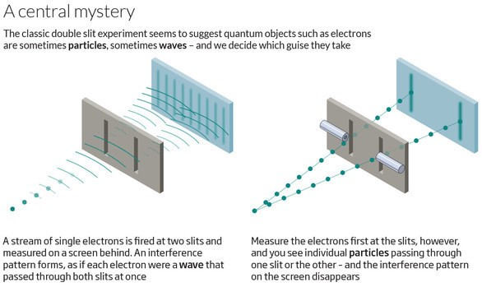
Quantum Double Slit Experiment

Slide 5
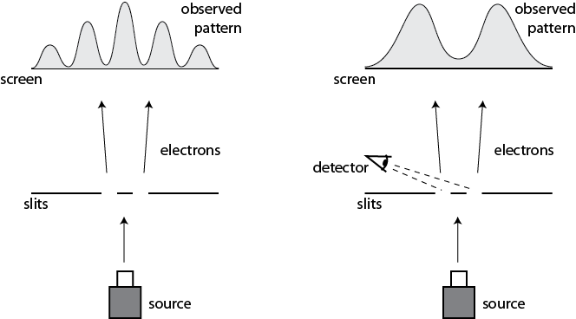
Quantum Double Slit Experiment
This happens even if we only allow a single electron at a time to pass through the slits

Slide 6
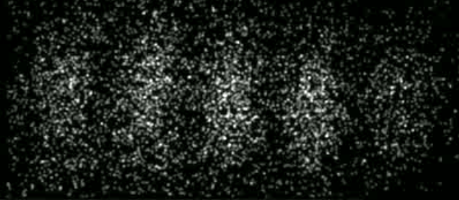
Quantum Double Slit Experiment
Time-Lapse Photograph of Single Electron Double-Slit Interference Pattern
In 1965, Richard Feynman called this the
"central mystery" of quantum theory, and then corrected himself, saying that in fact
"it is the only mystery"
Herman Batelaan, University of Nebraska-Lincoln, 2013

Slide 7
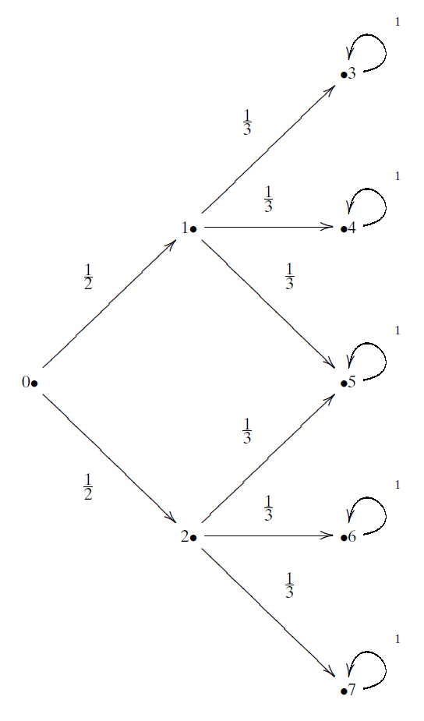
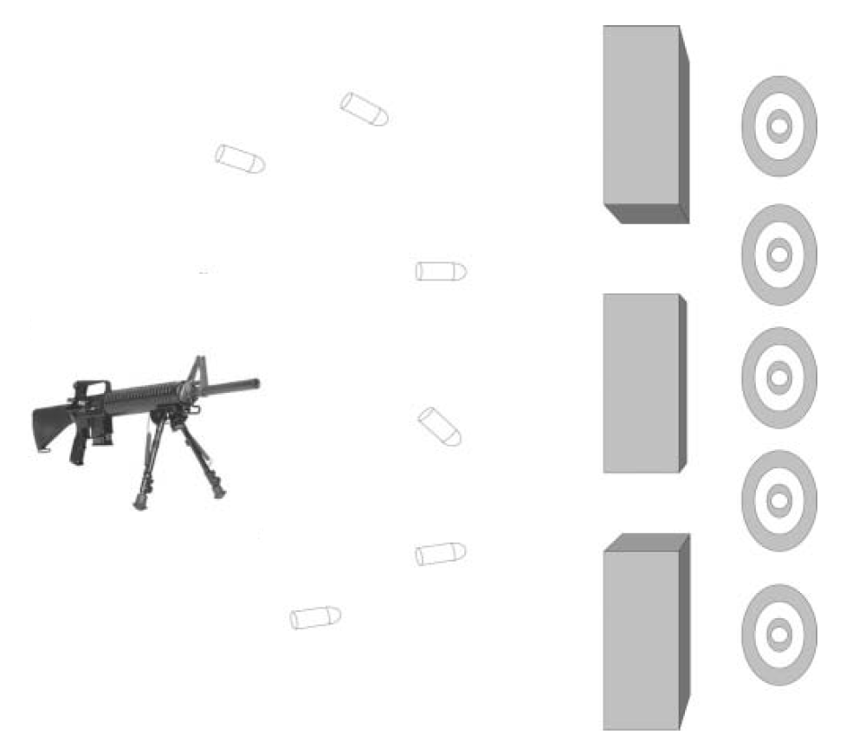
The Double Slit Experiment as a Matrix
Bullets
(Particles)
Transition Probability

Slide 8
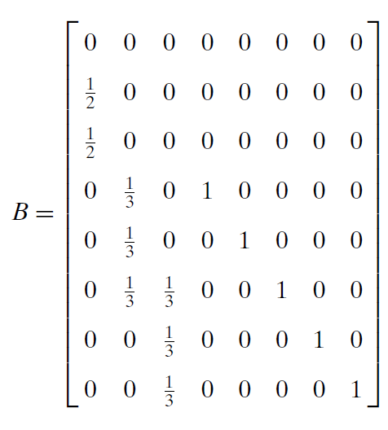
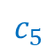
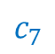
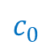
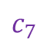
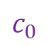
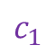
The Double Slit Experiment as a Matrix
FROM
$$c_{0}$$
$$c_{1}$$
$$c_{7}$$
$$c_{0}$$
TO
$$c_{5}$$
$$c_{7}$$
Bullet
Transition Probabilities For One Time Step

Slide 9
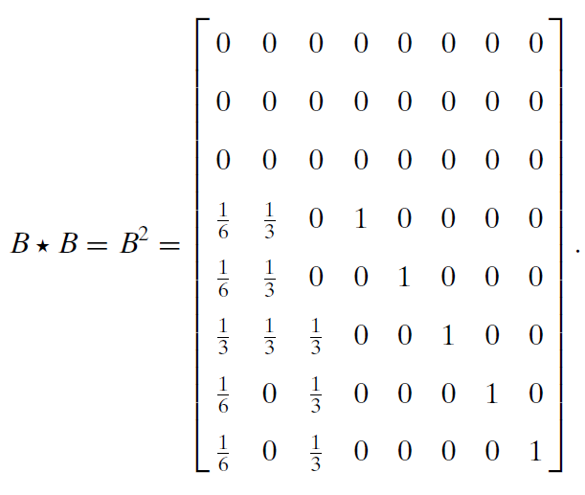
The Double Slit Experiment as a Matrix
Every time we multiple a transition matrix by itself,
we can calculate another time step (the next transition matrix)
Bullet
Transition Probabilities For
One Time Step
Bullet
Transition Probabilities After
Two Time Steps

Slide 10
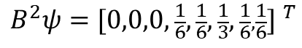
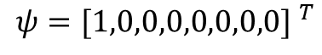
The Double Slit Experiment as a Matrix
Bullet Location Probabilities After Two Time Steps
$$ψ={[1,0,0,0,0,0,0,0] }^{T}$$
$$B^{2}ψ={[0,0,0,\frac{1}{6},\frac{1}{6},\frac{1}{3},\frac{1}{6},\frac{1}{6}] }^{T}$$

Slide 11
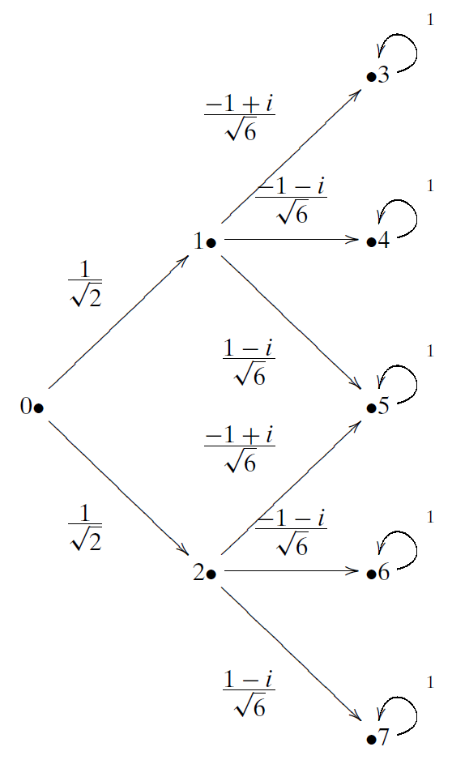
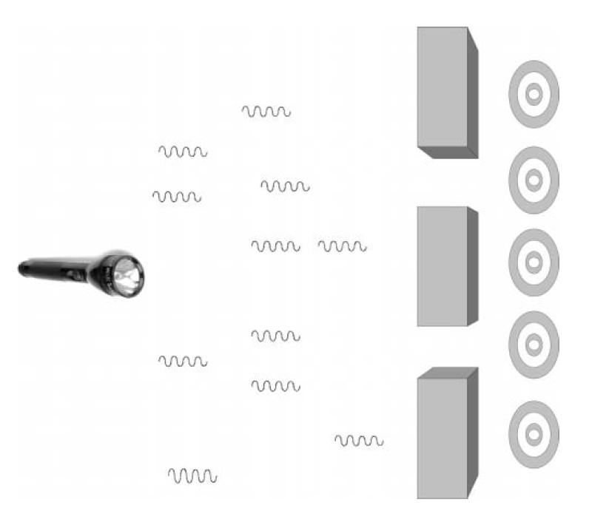
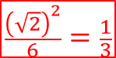
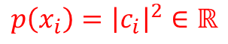
The Quantum Double Slit as a Matrix
Transition Amplitude
Photons
$$\frac{{\left(\sqrt{2}\right)}^{2}}{6}=\frac{1}{3}$$
$$\frac{1}{2}$$
When we square the norm of a transition amplitude, we get the transition probability
$$p\left(x_{i}\right)={\left|c_{i}\right|}^{2}∈ℝ$$

Slide 12
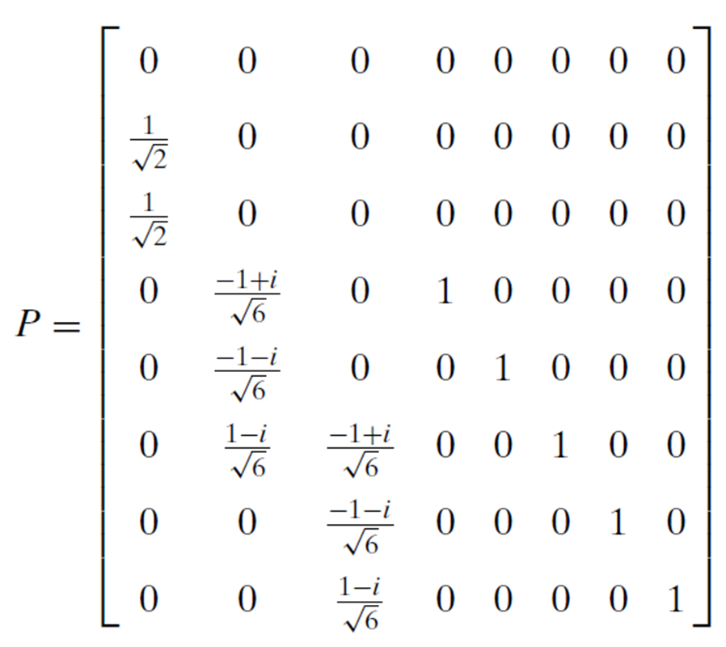
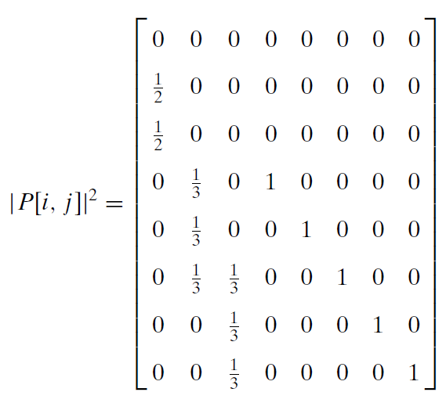
The Quantum Double Slit as a Matrix
When we measure a photon, its wave function collapses, and the norm squared of each amplitude becomes a probability
Photon
Transition Amplitudes For
One Time Step
Photon
Transition Probabilities For
One Time Step

Slide 13

The Quantum Double Slit as a Matrix
Once we measure the photon,
it acts like a bullet (a particle)…
$$=$$
Photon
Transition Probabilities For
One Time Step
Bullet
Transition Probabilities For
One Time Step

Slide 14
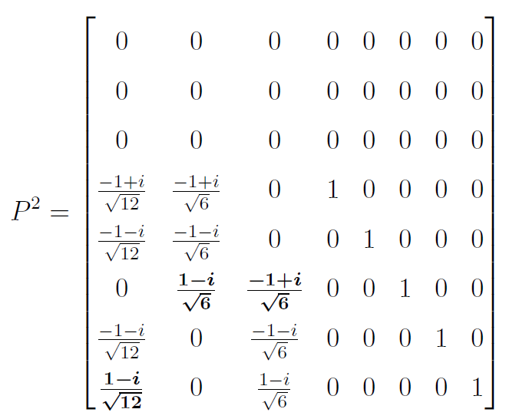

The Quantum Double Slit as a Matrix
If we do not measure the photon, we continue to use its transition amplitudes to calculate the next step…
$$P∙P$$
Photon
Transition Amplitudes For
One Time Step
Photon
Transition Amplitudes For
Two Time Steps

Slide 15
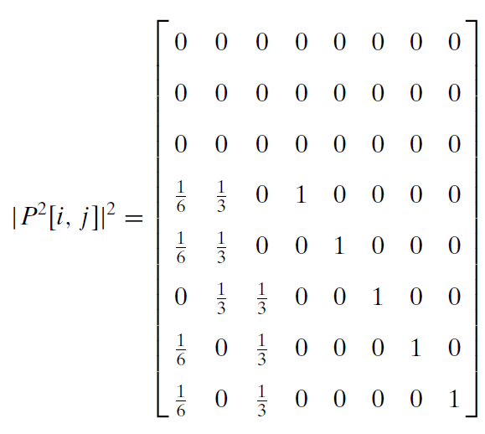
The Quantum Double Slit as a Matrix
If we measure the photon after the first step:
If we measure the photon only after the second step:
Photon
Transition Probabilities For
One Time Step
Photon
Transition Probabilities For
Two Time Steps

Slide 16

The Quantum Double Slit as a Matrix
If we wait to measure the photon only after two steps, we see it is acting like a wave (not like a particle)…
$$≠$$
Bullet
Transition Probabilities For
Two Time Steps
Photon
Transition Probabilities For
Two Time Steps

Slide 17
The Quantum Double Slit as a Matrix
Photons
Photon
Transition Probabilities For
Two Time Steps
The complex amplitudes in the photon's operator cause destructive interference

Slide 18
The Bloch Sphere
How can we visually represent a qubit on a printed page using only black & white ink?
$$\left.\left|ψ\right.\right\rangle =(a+bi)\left.\left|0\right.\right\rangle +(c+di)\left.\left|1\right.\right\rangle$$
It appears we must be able to plot four independent parameters: $\left(a,b,c,d\right)∈ℝ$
Therefore, we have a 4D object to visualize,
but we only have a 2D plane upon which we can draw
We cannot use the trick of indicating the 4th dimensional parameter using color in an oblique projection of a 3D surface

Slide 19
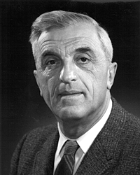
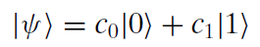
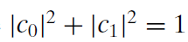
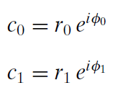
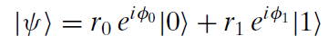
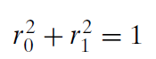
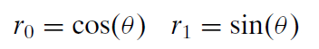
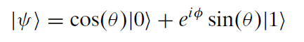
The Bloch Sphere
A complex number with a unit modulus is a point on a unit circle
Felix Bloch
(1905-1983)
Killing the phase of $\left.\left|0\right.\right\rangle$
$$φ=φ_{1}−φ_{0}$$
$$φ_{0}→0$$
Only two real parameters remain: $θ$ and $φ$

Slide 20
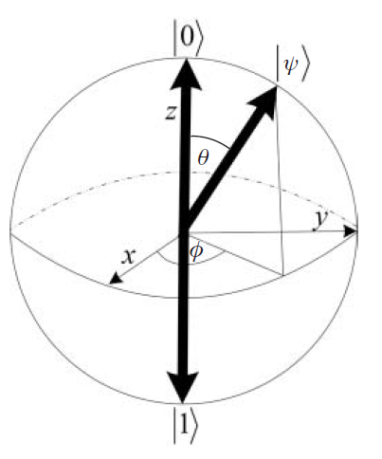
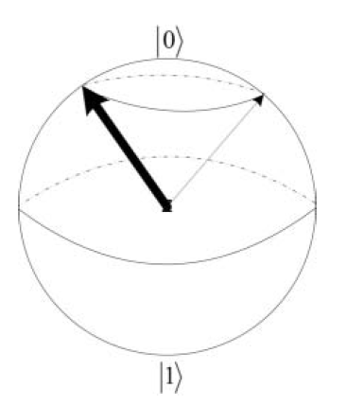
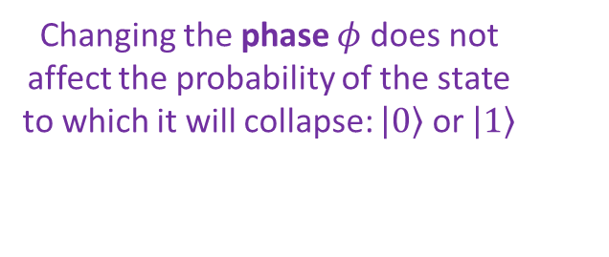
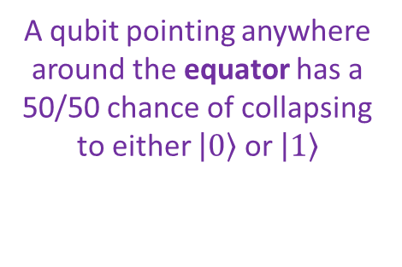
The Bloch Sphere
$$φ=φ_{1}−φ_{0}$$
A qubit pointing anywhere around the equator has a 50/50 chance of collapsing to either $\left.\left|0\right.\right\rangle$ or $\left.\left|1\right.\right\rangle$
Changing the phase $φ$ does not affect the probability of the state to which it will collapse: $\left.\left|0\right.\right\rangle$ or $\left.\left|1\right.\right\rangle$
Every unitary 2x2 operator (a quantum gate) will "rotate" this sphere in some way

Slide 21
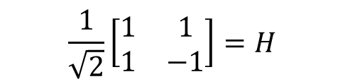
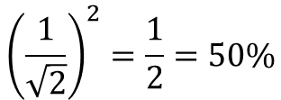
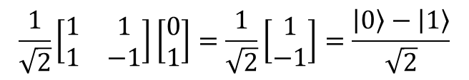
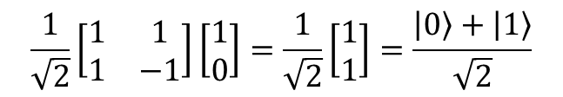
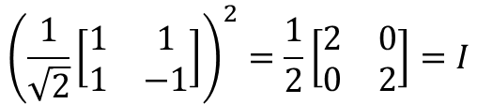
Unitary Matrices
$$\frac{1}{\sqrt{2}}\left[\begin{matrix}1 & 1 \\ 1 & −1\end{matrix}\right]=H$$
$${\left(\frac{1}{\sqrt{2}}\left[\begin{matrix}1 & 1 \\ 1 & −1\end{matrix}\right]\right)}^{2}=\frac{1}{2}\left[\begin{matrix}2 & 0 \\ 0 & 2\end{matrix}\right]=I$$
Hadamard Gate
Hadamard Matrix is Unitary
0
$$\frac{1}{\sqrt{2}}\left[\begin{matrix}1 & 1 \\ 1 & −1\end{matrix}\right]\left[\begin{matrix}1 \\ 0\end{matrix}\right]=\frac{1}{\sqrt{2}}\left[\begin{matrix}1 \\ 1\end{matrix}\right]=\frac{\left.\left|0\right.\right\rangle +\left.\left|1\right.\right\rangle }{\sqrt{2}}$$
A Hadamard gate puts a qubit into a superposition of states, with a 50/50 chance of getting a 0 or 1
1
$$\frac{1}{\sqrt{2}}\left[\begin{matrix}1 & 1 \\ 1 & −1\end{matrix}\right]\left[\begin{matrix}0 \\ 1\end{matrix}\right]=\frac{1}{\sqrt{2}}\left[\begin{matrix}1 \\ −1\end{matrix}\right]=\frac{\left.\left|0\right.\right\rangle −\left.\left|1\right.\right\rangle }{\sqrt{2}}$$
$${\left(\frac{1}{\sqrt{2}}\right)}^{2}=\frac{1}{2}=50\%$$
Note: these are not the same states, yet they have the same expectation values (probabilities) of 50% zero, 50% one

Slide 22
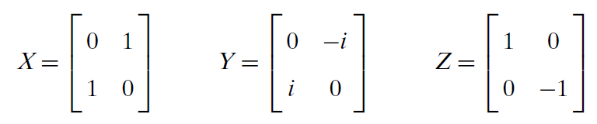
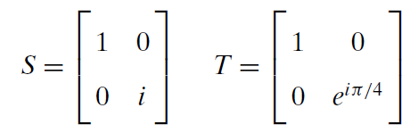
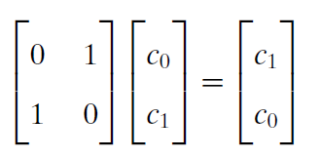
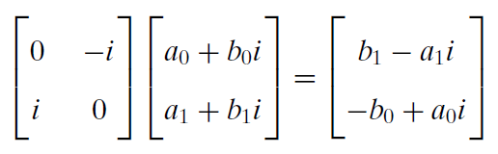
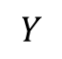
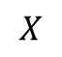
Unitary Matrices
Here are some additional fundamental unitary matrices that can act on qubits:
$$X$$
$$Y$$

Slide 23
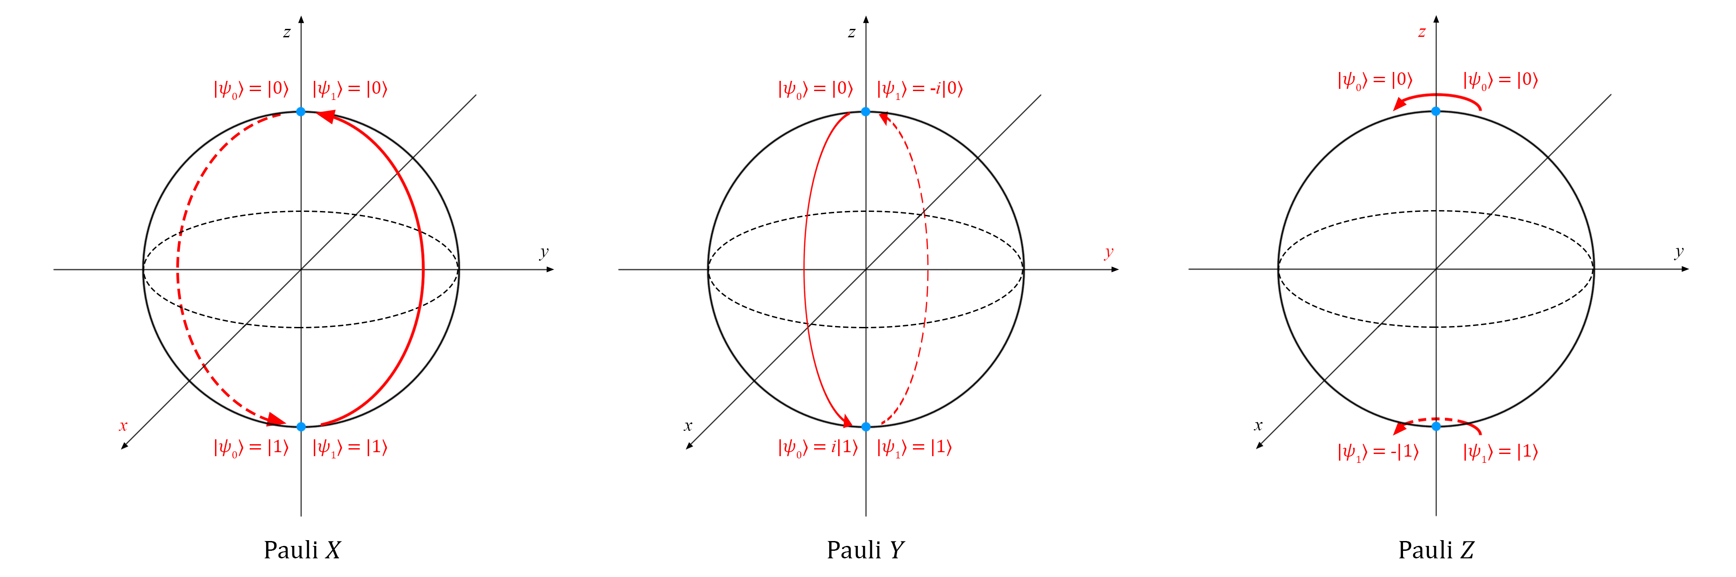
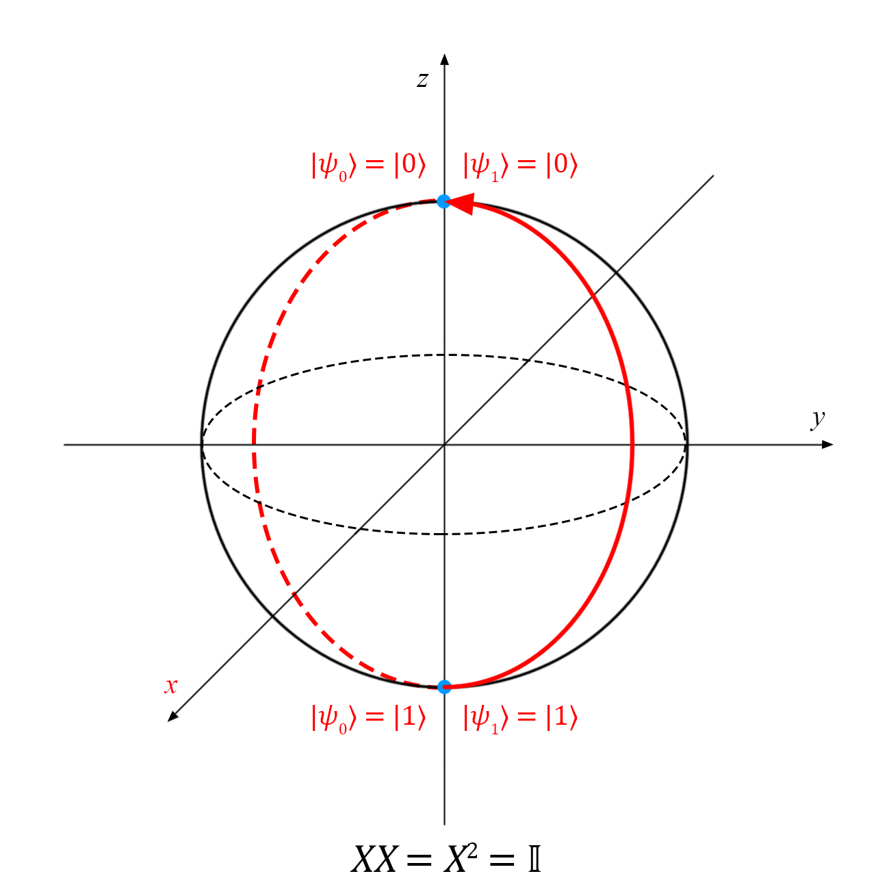
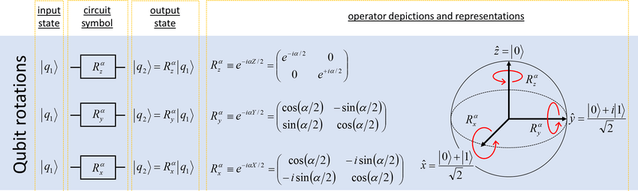
Unitary Matrices

Slide 24
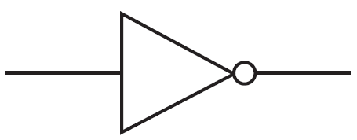












Quantum Gates
Reversible?
In the quantum world, all operations that are not measurements must be reversible and must be represented by unitary matrices
$$U⋅U^{†}=U^{†}⋅U=I$$
$$I_{n}⋅I_{n}=I_{n}$$
Controlled NOT (CNOT)
$⊗=$ Tensor Product
Control Line
$$NOT⋅NOT=I$$
1
1
$⊕=$ Binary XOR
Yes
1
Target
0
x y
in
out
x y
Will act only if the control line
$\left.|x\right\rangle$ is 1
CNOT is both reversible and universal
No

Slide 25


Quantum Gates
We cannot apply a negative phase angle to a target qubit in the $\left|\left.0\right\rangle \right.$ state, as $\left(−1\right)\left(0\right)=0$

Slide 26

Quantum Gates

Slide 27





Quantum Gates
Like the NAND and NOR gates, the CCNOT is
a universal gate for Boolean logic
Controlled Controlled NOT (CCNOT)
x y z
in
Control Line 1
1
1
out
Control Line 2
1
1
$$x∧y =x AND y$$
0
1
Acts only if both controls $\left.|x\right\rangle$and $\left.|y\right\rangle$are 1
CCNOT is reversible
$$X⋀Y$$ | $$z$$ | $$Z⊕\left(X⋀Y\right)$$
0 | 0 | 0
1 | 0 | 1
0 | 1 | 1
1 | 1 | 0
A Toffoli Gate

Slide 28



Quantum Gates
Controlled Swap (CSWAP)
x y z
in
Control Line
1
1
out
1
0
0
1
If control $\left.|x\right\rangle$ is 1,
$\left.|y\right\rangle$ and $\left.|z\right\rangle$ values are swapped
CSWAP is reversible
The CSWAP is
a universal gate for Boolean logic
A Fredkin Gate

Slide 29


Quantum Gates
Gates like CNOT and CCNOT are made by combining unitary matrices like X, Y, Z, S, T, and H
CNOT
CCNOT

Slide 30



Quantum Gates
We can create a SWAP gate using three CNOT gates or six Hadamard Gates + three CZ Gates

Slide 31

Quantum Gates

Slide 32


Amplitude vs. Probability
Addition is Commutative, Subtraction is NOT
Note: these are not the same states, yet they have the same expectation values (probabilities)

Slide 33







Amplitude vs. Probability
$$\sqrt{NOT}$$
$$\sqrt{NOT}$$
But are these two "zeros" the same state?
Scalar multiplication of $\left.\left|ψ\right.\right\rangle$ does not change the probabilities
$$\left.\left(s\right)\left|ψ\right.\right\rangle ⟼p\left(x_{i}\right)$$
Refer to these:
Session 14 - Slide 65
Session 22 - Slide 50

Slide 34

Representing Multiple Qubits
$${\left[\begin{matrix}0 \\ 1\end{matrix}\right]}^{⨂3}=\left[\begin{matrix}0 \\ 1\end{matrix}\right]⨂\left[\begin{matrix}0 \\ 1\end{matrix}\right]⨂\left[\begin{matrix}0 \\ 1\end{matrix}\right]$$
$$=\left[\begin{matrix}0 \\ 1\end{matrix}\right]⨂\left[\begin{matrix}\left(0\right)\left[\begin{matrix}0 \\ 1\end{matrix}\right] \\ \left(1\right)\left[\begin{matrix}0 \\ 1\end{matrix}\right]\end{matrix}\right]=\left[\begin{matrix}0 \\ 1\end{matrix}\right]⨂\left[\begin{matrix}0 \\ 0 \\ 0 \\ 1\end{matrix}\right]$$
0
$$=\left[\begin{matrix}\left(0\right)\left[\begin{matrix}0 \\ 0 \\ 0 \\ 1\end{matrix}\right] \\ \left(1\right)\left[\begin{matrix}0 \\ 0 \\ 0 \\ 1\end{matrix}\right]\end{matrix}\right]=\left[\begin{matrix}0 \\ 0 \\ 0 \\ 0 \\ 0 \\ 0 \\ 0 \\ 1\end{matrix}\right]=\left|\left.111\right\rangle \right.$$
$${111}_{2}=7_{10}$$
7

Slide 35









Representing Multiple Qubits
0
1
1
0
1
0
1
1
A qubyte
$${\left(ℂ^{2}\right)}^{⊗8}=ℂ^{256}$$
0
107
255

Slide 36







Run Cells 1 to 7 – quantum_gates.ipynb
Demonstrate the following seven identities by applying the operator matrices for quantum gates
$$\#1) X^{2}=Y^{2}=Z^{2}=I$$
$$\#5) −1Y=HYH$$
$$\#2) H=\frac{1}{\sqrt{2}}(X+Z)$$
$$\#6) {S=T}^{2}$$
$$\#3) X=HZH$$
$$\#7) −1Y=XYX$$
$$\#4) Z=HXH$$

Slide 37


Run Cell 1 quantum_gates.ipynb
①
②
③
④
⑤
⑥
⑦
⑧

Slide 38






Run Cells 2 to 4 – quantum_gates.ipynb

Slide 39






Run Cells 5 to 7 – quantum_gates.ipynb

Slide 40


No Cloning Theorem
Can we send the same input qubit to two different output lines?
Controlled Swap (CSWAP)
Controlled Controlled NOT (CCNOT)
A NOT symbol
Can we use a CSWAP to produce a fanout?
Can we use a CCNOT to produce a fanout?
A Fredkin Gate
A Toffoli Gate

Slide 41










No Cloning Theorem
"We can cut-n-paste, but not copy-n-paste"
$$\left.\left|x\right.\right\rangle =\frac{\left.\left|0\right.\right\rangle +\left.\left|1\right.\right\rangle }{\sqrt{2}}=\left[\begin{matrix}\frac{1}{\sqrt{2}} \\ \frac{1}{\sqrt{2}}\end{matrix}\right]$$
$x$ is in superposition
$$x=0/1,y=1, z=0$$
$$y$$
$$z$$
in
out
in
$$\frac{\left|\left.0,1,0\right\rangle \right.+\left|\left.1,1,0\right\rangle \right.}{\sqrt{2}}$$
out
$$\frac{\left|\left.0,1,0\right\rangle \right.+\left|\left.1,0,1\right\rangle \right.}{\sqrt{2}}$$
The output state is not an exact copy of the input state

Slide 42

Impress Me
Show how the CCNOT gate shown on slide #27 cannot exactly clone this input state: $x=\left|\left.1\right\rangle \right.$, $z=\left|\left.0\right\rangle \right.$, and $y$ is a 50/50 superposition:
$$\frac{\left|\left.1,0,0\right\rangle \right.+\left|\left.1,1,0\right\rangle \right.}{\sqrt{2}}$$
Note: the no cloning theorem says you cannot clone any arbitrary state (e.g., all possible states) but you might be able to clone a single specific state

Slide 43

IBM Qiskit
https://qiskit.org

Slide 44

IBM Qiskit
https://qiskit.org/learn

Slide 45

IBM Qiskit
https://qiskit.org/textbook

Slide 46

IBM Qiskit
Qiskit Foundations - Coding With Qiskit - Season 1

Slide 47

Phase Encoding
Because the amplitudes of a qubit can be negative complex numbers, we can encode information in the qubit's phase
$$\left|\left.ψ\right\rangle =c_{0}\left|\left.0\right\rangle \right.+c_{1}\left|\left.1\right\rangle \right.\right.$$
We lose this phase information when we measure a qubit because probabilities must be exclusively positive real numbers
But while a quantum state evolves, as coaxed by a quantum circuit/algorithm, we can leverage these negative complex phases to induce destructive interference
The phase of one qubit can be used to influence the phase of other qubits in the circuit

Slide 48



Phase Encoding
A pure classical state can only be 0 or 1, but a pure qubit state could have a variety of "equal" amplitudes:
Remember we take the norm (absolute value) of the squared amplitudes to determine the expected value (the Born Rule), so the top row would all measure as 0, and the bottom row would all measure as 1
A key to designing quantum algorithms is deftly using all four ways a 1 can be represented as a complex number ☺
$$\left|\left.0\right\rangle \right.$$
$$\left[\begin{matrix}1 \\ 0\end{matrix}\right]$$ | $$\left[\begin{matrix}−1 \\ 0\end{matrix}\right]$$ | $$\left[\begin{matrix}i \\ 0\end{matrix}\right]$$ | $$\left[\begin{matrix}−i \\ 0\end{matrix}\right]$$
$$\left[\begin{matrix}0 \\ 1\end{matrix}\right]$$ | $$\left[\begin{matrix}0 \\ −1\end{matrix}\right]$$ | $$\left[\begin{matrix}0 \\ i\end{matrix}\right]$$ | $$\left[\begin{matrix}0 \\ −i\end{matrix}\right]$$
$$\left|\left.1\right\rangle \right.$$

Slide 49







Run Cell 1 phase_encoding.ipynb
①
②
③
④
$$\left|0⟩\right.$$
⑤
⑥
⑦
⑧
⑨
$$\left|\left.0\right\rangle \right.→\left[\begin{matrix}−1 \\ 0\end{matrix}\right]→\left[\begin{matrix}1 \\ 0\end{matrix}\right]→0$$
⑩
When measured…

Slide 50








Run Cell 2 phase_encoding.ipynb
①
②
$$\left|0⟩\right.$$
③
④
⑤
$$\left|\left.0\right\rangle \right.→\left[\begin{matrix}i \\ 0\end{matrix}\right]→\left[\begin{matrix}−1 \\ 0\end{matrix}\right]→0$$
⑥
When measured…

Slide 51








Run Cell 3 phase_encoding.ipynb
①
②
$$\left|0⟩\right.$$
③
④
⑤
$$\left|\left.0\right\rangle \right.→\left[\begin{matrix}−i \\ 0\end{matrix}\right]→\left[\begin{matrix}−1 \\ 0\end{matrix}\right]→0$$
⑥

Slide 52





Run Cell 4 phase_encoding.ipynb
①
②
③
④
⑤
⑥
⑦
$$\left|\left.0\right\rangle \right.→\left[\begin{matrix}−i \\ 0\end{matrix}\right]→\left[\begin{matrix}−1 \\ 0\end{matrix}\right]→0$$
⑧

Slide 53




Run Cell 5 phase_encoding.ipynb
①
$$\left|\left.0\right\rangle \right.→\left[\begin{matrix}0 \\ −1\end{matrix}\right]→\left[\begin{matrix}0 \\ 1\end{matrix}\right]→1$$

Slide 54




Run Cell 6 phase_encoding.ipynb
①
$$\left|\left.0\right\rangle \right.→\left[\begin{matrix}0 \\ i\end{matrix}\right]→\left[\begin{matrix}0 \\ −1\end{matrix}\right]→1$$

Slide 55




Run Cell 7 phase_encoding.ipynb
①
$$\left|\left.0\right\rangle \right.→\left[\begin{matrix}0 \\ −i\end{matrix}\right]→\left[\begin{matrix}0 \\ −1\end{matrix}\right]→1$$

Slide 56





Run Cell 8 phase_encoding.ipynb
①
②
③
④
$$\left|\left.0\right\rangle \right.→\left[\begin{matrix}0 \\ −i\end{matrix}\right]→\left[\begin{matrix}0 \\ −1\end{matrix}\right]→1$$
⑤

Slide 57

Quantum Superposition
Things are simple enough for an individual qubit:
$$\left|\left.ψ\right\rangle =c_{0}\left|\left.0\right\rangle \right.+c_{1}\left|\left.1\right\rangle \right.\right.$$
The picture is more difficult for a quantum register containing many qubits:
$$\left|\left.ψ\right\rangle =c_{0}\left|\left.00\right\rangle \right.+c_{1}\left|0\left.1\right\rangle \right.\right.+c_{2}\left|\left.10\right\rangle \right.+c_{3}\left|1\left.1\right\rangle \right.$$
Superposition doesn't mean the qubit is simultaneously assuming all possible values at every instant – it has a singular definite value at any moment - but we cannot know that value (when we measure it becomes 0 or 1 only)
Superposition is not entanglement – an isolated qubit in superposition does not affect other qubits

Slide 58

Run Cell 1 – superposition.ipynb
①
②
③
④
⑤
⑥

Slide 59




Run Cell 2 – superposition.ipynb
sv1
sv2
①
②
③
④
⑤
⑥
⑦
⑧
⑨
⑩

Slide 60





Run Cell 3 – superposition.ipynb
sv1
sv2
①
②
③
④
Note: Without any measurements,
the histogram is based solely on the final state vector (amplitudes² = probabilities)

Slide 61







Run Cell 4 – superposition.ipynb
①
②
③
④
A negative phase doesn't change the probability of ultimately measuring a $\left|\left.0\right\rangle \right.$ or a $\left|\left.1\right\rangle \right.$
In the final state vector, it is still a 50/50 chance

Slide 62

Run Cell 4 – superposition.ipynb
①
②
③
④
Any qubit that starts in the $\left|\left.1\right\rangle \right.$ state and remains in the $\left|\left.1\right\rangle \right.$ state, after applying a Hadamard gate (H) to that qubit,
picks up a negative phase
A negative phase doesn't change the probability of ultimately measuring a $\left|\left.0\right\rangle \right.$ or a $\left|\left.1\right\rangle \right.$
In the final state vector, it is still a 50/50 chance

Slide 63






Run Cell 5 – superposition.ipynb
①
②
③

Slide 64












Run Cell 6 – superposition.ipynb
sv1
sv2
sv3
sv4
$$X\left(\left|\left.1\right\rangle \right.\right)=\left|\left.0\right\rangle \right.$$
①
②
$$\left|\left.1\right\rangle \right.$$
$$\left|\left.−\right\rangle \right.$$
③
$$\left|\left.0\right\rangle \right.$$
$$\left|\left.+\right\rangle \right.$$

Slide 65



Run Cell 7 – superposition.ipynb
Qubit index
①
③
②
④
Using more (measured) shots will bring us closer to the expected outcomes
$$p\left(\left|\left.0\right\rangle \right.\right)={\left(\frac{\sqrt{3}}{2}\right)}^{2}=\frac{3}{4}=0.75$$
$$p\left(\left|\left.1\right\rangle \right.\right)={\left(\frac{1}{2}\right)}^{2}=\frac{1}{4}=0.25$$

Slide 66


Run Cell 8 – superposition.ipynb
①
②
Using 10,000 shots brings us closer to the expected outcomes (think Monte Carlo)
$$p\left(\left|\left.0\right\rangle \right.\right)={\left(\frac{\sqrt{3}}{2}\right)}^{2}=\frac{3}{4}=0.75$$
$$p\left(\left|\left.1\right\rangle \right.\right)={\left(\frac{1}{2}\right)}^{2}=\frac{1}{4}=0.25$$

Slide 67

IBM Qiskit Bitstring Notation
In IBM Qiskit, quantum states follow this convention:
$$\left|\left.MSB,⋯,LSB\right\rangle \right.$$
This means the most significant bit (MSB) of the decimal index number of a tensor state appears first, and the least significant bit (LSB) comes before the right-angle bracket:
Qiskit way: $\left|\left.z,y,x\right\rangle \right.$ vs. Physicists way: $\left|\left.x,y,z\right\rangle \right.$
This is a backward ordering scheme compared to the approach shown on slides # 24 - # 28, but it does follow how we tend to express binary numbers (left to right):
$$c_{6}\left|\left.1,1,0\right\rangle \right.≡Amplitude of state 6→{110}_{2}=6_{10}$$

Slide 68









IBM Qiskit Bitstring Notation
$$ψ=\left|\left.MSB,⋯,LSB\right\rangle \right.$$
$$\left.\left|1\right.\right\rangle$$
$$\left.\left|0\right.\right\rangle$$
$$\left.\left|1\right.\right\rangle$$
$$ψ=\left|\left.q_{2},q_{1},q_{0}\right\rangle \right.=\left.\left|1,0,1\right.\right\rangle$$
Ket state
Bit string
$${101}_{2}=5_{10}$$
$$\begin{matrix}0 & 1 & 2 & 3 & 4 & 5 & 6 & 7\end{matrix}$$
Tensor state
$$ψ={\left[\begin{matrix}0 & 0 & 0 & 0 & 0 & 1 & 0 & 0\end{matrix}\right]}^{T}$$

Slide 69

Quantum Entanglement
An essential distinguishing feature between qubits and classical bits is the phenomenon called entanglement
Quantum entanglement is a nonlocal property of two or more qubits that allows a set of qubits to express higher correlation than is possible in classical systems
Controlled gates (CNOT, CCNOT, CSWAP, etc.) can entangle qubits if the control lines begin in superposition – if you measure one, the other entangled qubits instantly assume a specific value – no matter how far apart the qubits may physically reside

Slide 70









Run Cell 1 entanglement.ipynb
①
Both qubits are initialized to the $\left|\left.0\right\rangle \right.$ state
②
③
④
⑤
⑥
$$\left|\left.q_{1}q_{0}\right\rangle \right.$$
$$\left|\left.q_{1}q_{0}\right\rangle \right.$$
$q_{0}$ is in a 50/50 superposition

Slide 71




Run Cell 1 entanglement.ipynb
①
Initial $ψ$
Both qubits are initialized to the $\left|\left.0\right\rangle \right.$ state
②
③
④
Final $ψ$
⑤
⑥
0 1 2 3
$$\left|\left.q_{1}q_{0}\right\rangle \right.$$
$$\left|\left.q_{1}q_{0}\right\rangle \right.$$
$q_{0}$ is in a 50/50 superposition

Slide 72








Run Cell 2 entanglement.ipynb
①
cx(q0, q1) =
Controlled (by q0) NOT (on q1)
Initial $ψ$
②
③
Final $ψ$
q1 "follows" q0
They are entangled
0 1 2 3
$$\left|\left.q_{1}q_{0}\right\rangle \right.$$
③
④
$$\left|\left.q_{1}q_{0}\right\rangle \right.$$

Slide 73



Run Cell 3 entanglement.ipynb
①
②
③
$$p\left(\left|\left.00\right\rangle \right.\right)={\left(\frac{1}{\sqrt{2}}\right)}^{2}=\frac{1}{2}=0.50$$
$$p\left(\left|\left.11\right\rangle \right.\right)={\left(\frac{1}{\sqrt{2}}\right)}^{2}=\frac{1}{2}=0.50$$

Slide 74


Exponential Growth in $ψ$ Size
A natural question is this: If not taking any measurements gives us exactly the expected results, but taking multiple shots results in a histogram that deviates away from the exact results, why would we ever use multiple shots?
The answer is that we are creating tiny circuits whose state vector has a small number of amplitudes
A quantum circuit having 45 qubits would require a state vector with $2^{40}$ amplitudes ($×2$ to hold the real and imaginary components $×8$ bytes for 64-bit precision of both components) $=563 TB of RAM$ but the current maximum RAM in Linux is only $256 TB$
We cannot store such a large state vector in a classical computer, but we can execute the circuit thousands of times on a real quantum computer, measuring the result of each shot, and then tally the outcomes in order to create a histogram

Slide 75





Run Cell 4 entanglement.ipynb
①
②
③
④
sv1
sv2
sv3
$$\left|\left.q_{2}q_{1}q_{0}\right\rangle \right.$$
$q_{0}$ and $q_{0}$are in independent 50/50 superpositions

Slide 76



Run Cell 5 entanglement.ipynb
①
②
Using more shots will bring us closer to the expected outcomes
③

Slide 77




Run Cell 6 entanglement.ipynb
①
0
000
4
100
cx(q0, q2) =
Controlled (by q0) NOT (on q2)
3
011
②
7
111
③
SWAP
0 1 2 3 4 5 6 7

Slide 78
Check Cell 6 entanglement.ipynb
0 1 2 3 4 5 6 7

Slide 79




Run Cell 7 entanglement.ipynb
①
0
3
4
7
Using more shots will bring us closer to the expected outcomes
0 1 2 3 4 5 6 7

Slide 80




Run Cell 8 entanglement.ipynb
①
"Together"
All qubits are entangled
$$\frac{\left|\left.000\right\rangle \right.+\left|\left.111\right\rangle \right.}{\sqrt{2}}$$

Slide 81




Run Cell 9 entanglement.ipynb
①
0 1 2 3 4 5 6 7
1 2 4
"Individual"
All qubits are entangled
$$\frac{\left|\left.001\right\rangle \right.+\left|\left.010\right\rangle \right.+\left|\left.100\right\rangle \right.}{\sqrt{3}}$$

Slide 82




Run Cell 10 entanglement.ipynb
①
②

Slide 83



Run Cell 10 entanglement.ipynb
Maximally entangled qubits would both rest at the origin inside a Bloch sphere, so we must use Qiskit's plot_state_qsphere() to visualize both qubits
①
②

Slide 84


Run Cell 10 entanglement.ipynb
①
②

Slide 85


Run Cell 10 entanglement.ipynb
①
②

Slide 86

Run Cell 10 entanglement.ipynb
①
②
Any qubit that starts in the $\left|\left.1\right\rangle \right.$ state and remains in the $\left|\left.1\right\rangle \right.$ state, after applying a Hadamard gate (H) to that qubit,
picks up a negative phase

Slide 87
Quantum Simulating Classical
All classical digital logic (Boolean) gates can be simulated using quantum gates
Quantum gates represent operators, and quantum operators can be represented as unitary matrices
Quantum computation must be reversible therefore ancilla bits may be required to allow unambiguous reconstruction of the initial input state
Time reversible algorithms require zero net energy to compute but not to "host" – consider the chillers required to keep current quantum circuits near absolute zero (20 millikelvin)

Slide 88






Run Cell 1 boolean_gates.ipynb
①
Both qubits are set to the $\left|\left.1\right\rangle \right.$ state
②
③
④
ccx(q0, q1, q2) =
Controlled (by q0)
Controlled (by q1) NOT (on q2)
⑤
⑥
1
CCNOT
1
1
1
1
1

Slide 89




Run Cell 2 boolean_gates.ipynb
①
②
Uncomment these lines to test the output based upon input permutations
All classical (Boolean) logic gates can be constructed from quantum gates
0
CCNOT
0
0
0
0
0

Slide 90





Run Cell 3 – boolean_gates.ipynb
①
②
Full Adder
③

Slide 91



Run Cell 4 – boolean_gates.ipynb
①
④
Full Adder
⑤
⑥
⑦
②
③
⑧

Slide 92

CNOT Gate – Physical Implementation

Slide 93
Session 23 – Now You Know…
Due to the cancelling effects of complex amplitudes, wavefunctions can exhibit destructive interference
Each qubit we track in a circuit exponentially increases the output vector space (number of elements in the state vector) due to tensor multiplication
Quantum gates can be represented by unitary matrices as all computation effects must be reversible
Toffoli (CCNOT) and Fredkin (CSWAP) are universal gates
The No Cloning Theorem prevents making an exact copy of any qubit – but we can "copy" the probabilities of reading a qubit's values (just not both the probability and the phase)

Slide 94
Session 23 – Now You Know…
IBM Qiskit is a premier development toolkit for writing quantum computer algorithms in Python
You can experiment with the Qiskit libraries within interactive Jupyter notebooks by executing cells of code
Most toy abstractions (like PETE boxes) are an attempt to avoid using complex numbers and Euler's formula for imaginary exponentials - do not avoid linear algebra
Quantum algorithms cleverly manipulate the phase of qubits in a register to shape probabilities in their favor
Many quantum algorithms offer significant speed-up over their classical counterparts and new discoveries are being made every day – it is your generation's new frontier!

Slide 95

Task 23-01 (Part A)
Edit quantum_circuit1.ipynb to implement the circuit below by applying the correct IBM Qiskit quantum gates and saving the four designated state vectors:
sv1
sv2
sv3
sv4

Slide 96
Task 23-01 (Part B)
After implementing the circuit in Task 23-01 Part A, answer the following two questions in Cell 2 of your notebook:
Using the truth table below as a reference, explain the results depicted in state vector 4:
Explain why is there a 100% chance of measuring only a value of 0 for the single classical bit?
Upload your solution to the BNL QIS101 SharePoint site

Slide 97

Task 23-02
Edit quantum_circuit2.ipynb to implement and display an IBM Qiskit circuit that has an equal probability of generating a state vector representing only 63 or 64
Upload your solution to the BNL QIS101 SharePoint site

Slide 98


Task 23-03
Create a new file quantum_circuit3.ipynb that implements this circuit and displays the histogram after 1,024 shots
In Cell 2 of your notebook, explain the exact probability $q_{6}=1$ if there was no quantum noise
Upload your solution to the BNL QIS101 SharePoint site

